Slide 1
EVALUATION OF ALTERNATIVES Rate of Return

Slide 2
Introduction
An independent alternative is still considerable if the rate of return is equal or higher than the minimum acceptable rate of return (MARR).
It means the lowest level of return an organization can accept.
In general this level should not be lower than the cost of capital investment, and considerably higher than this level.
The higher limit depends on the objective, policies and some circumstances of the organization.

Slide 3
Principle
The alternative which meets the MARR value can be determined, by calculating the internal rate of return (IRR), under possible reinvestment constraints.
Rate of return (ROR) is the rate paid on the unpaid balance of borrowed money, or the rate earned on the unrecovered balance of an investment, so that the final payment or receipt brings the balance to exactly zero with interest considered.

Slide 4
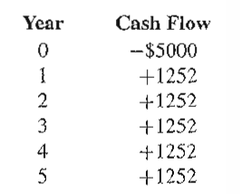
Example
If a Rs.5000 is invested on a machine with a 5 year useful life and an equivalent uniform annual benefits of Rs. 1252, then the cash flows is as shown below,
An appropriate question is, What rate of return would we receive on this investment?

Slide 5
Types of Rate of Return
Rate of return is the percentage that indicates the relative yield on different uses of capital.
Following rate of returns are frequently used,
The minimum acceptable rate of return (MARR)
Lowest level of return at which the investment is acceptable.
The limit is set by individuals or organizations.
It ensures the best possible use of limited resources.

Slide 6
The Internal Rate of Return (IRR)
It is the rate on the unrecovered balance of the investment where the terminal balance is zero.
External Rate of Return (ERR)
It is the possible rate of return for an investment under current economic conditions

Slide 7
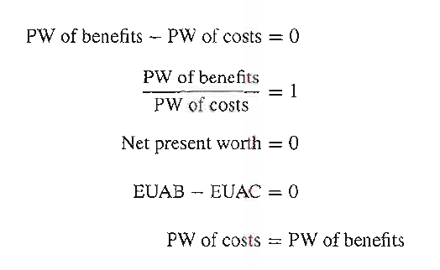
Procedure
To calculate rate of return on an investment, we must convert the various consequences of the investment into cash flow.
Then will solve the cash flow for unknown value of internal rate of return (IRR).
Five forms of cash flow equations are as follows:

Slide 8
SINGLE SIMPLE INVESTMENT
An $8200 investment returned $2000 per year over a 5-year useful life. What was the rate of return on the investment?

Slide 9
West Texas Oil has paid Rs.3,00,000 for producing oil well. Field engineers estimate that net receipts will be Rs.1,20,000 for the first year of operation with a reduction of 15% of the first year receipt ,for every year thereafter till the end of five years. It plans to sell well after 5 years for Rs80,000. how does this seem financially if their MARR is 20%?

Slide 10
A patch of land adjacent to the proposed international airport is likely to increase in value. The cost of land now is INR 8,00,000 and is expected to be worth INR 15,00,000 within 5 years. During this period it can be rented for small scale industry at INR 15000 per year. Annual taxes are presently is INR 8500 and likely to remain constant. What rate of return will be earned on the investment if the estimates are accurate?

Slide 11
A firm has identified three mutually exclusive investment proposals whose details are as given below. The life of all the alternatives are estimated to be for 5years, with negligible salvage value. MARR for the firm is 12%. Find the best alternative based on ROR method of comparison.
 | A1 | A2 | A3
INVESTMENT | Rs.1,50,000 | 2,10,000 | 2,55,000
ANNUAL NET INCOME | Rs.45,570 | 58,260 | 69,000

Slide 12
Consider three mutually exclusive alternatives, each having an 8-year of useful life. If MARR is 8%, which alternative should be selected?
 | A | B | C
Initial Costs, $ | 1000 | 800 | 600
Uniform annual benefit, $/year | 122 | 120 | 97
Salvage value | 750 | 500 | 500

Slide 13
Incremental Cash Flow Analysis (Mutually exclusive alternatives)
Under some circumstances, project ROR values do not provide the same ranking of alternatives as do PW, AW, and FW analyses. This situation does not occur if we conduct an incremental cash flow ROR analysis.
Incremental analysis can be defined as the examination of the differences between alternatives.
By emphasizing alternatives, we are really deciding whether or not differential costs are justified by differential benefits.

Slide 14
Comparing Mutually Exclusive Alternatives Based on IRR
Issue: Can we rank the mutually exclusive projects by the magnitude of its IRR?
n A1 A2
0
1
IRR
-$1,000 -$5,000
$2,000 $7,000
100% > 40%
$818 < $1,364
PW (10%)

Slide 15

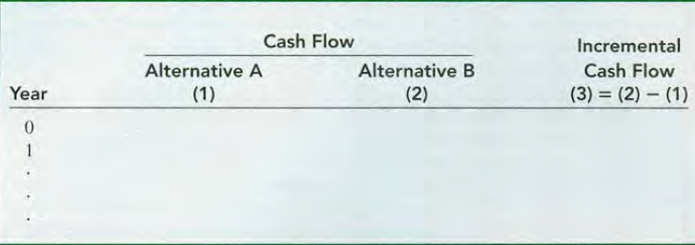
Convention
Only for the purpose of simplification, use the convention that between two alternatives, the one with the larger initial investment will be regarded as alternative B.

Slide 16
General Types of Incremental IRR Numerical
The initial investment and annual cash flows for each alternative (excluding the salvage value) occur in one of two patterns:
Revenue alternative, where there are both negative and positive cash flows.
Service alternative, where all cash flow estimates are negative.

Slide 17
NUMERICAL
Consider the following two sets of mutually exclusive alternatives. MARR= 6%. Which alternative should be selected?
YEAR | A1 | A2
0 | -$10 | -$20
1 | $15 | $28

Slide 18
Consider the following 3 sets of mutually exclusive alternatives. Which project would you select on the basis of the ROR on incremental investment, assuming MARR=15%?
N | D1 ($) | D2 ($) | D3 ($)
0 | -$2000 | -1000 | -3000
1 | 1500 | 800 | 1500
2 | 1000 | 500 | 2000
3 | 800 | 500 | 1000
IRR | 34.37% | 40.76% | 24.81%

Slide 19
For MARR of 6% and each alternative having a life of 20 years with no salvage value and cost information as shown in table below,
Which Alternative is preferred? Use Incremental IRR method.
 | A | B | C
Initial Costs, $ | 2000 | 4000 | 5000
Uniform annual benefit, $/year | 410 | 639 | 700

Slide 20
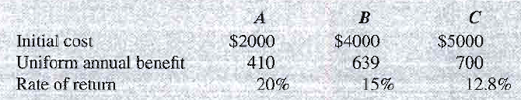
Since all IRR > MARR, None of the Alternative is Rejected.
Now Carrying out Incremental IRR between the 3 Alternatives

Slide 21
In 2000, Bell Atlantic and GTE merged to form a giant telecommunications corporation named Verizon Communications. As expected, some equipment incompatibilities had to be rectified, especially for long distance and international wireless and video services. One item had two suppliers-a U.S. firm (A) and an Asian firm (B). Approximately 3000 units of this equipment were needed. Estimates for vendors A and B are given for each unit. Determine which vendor should be selected if the MARR is 15% per year, using the increment in the investment.
 | A | B
Initial Cost, $ | -8000 | -13000
Annual Cost, $ | -3500 | -1600
Salvage Value, $ | 0 | 2000
Life, Years | 10 | 5

